Slide 1
ONLINE ADMISSION PORTAL
PRESENTED BY:-
VIVEK KUMAR(191500919)
RACHIT SINGH(191500616)
YASH SRIVATSAVA(191500932)
KAPIL JADAUN(191500379)

Slide 2
WELCOME TO PROJECT

Slide 3
OUTLINE
About the Project
Objective
Requirements
Snapshots from the website

Slide 4
ABOUT THE PROJECT
Our FullStack project is online admission portal that helps student to register for new admission or for login of regular student

Slide 5
OBJECTIVE
User friendliness: The project should be very easy to use enabling even a novice person to use it
Easy to login
Easy to Register

Slide 6
REQUIREMENTS
Software Specification Used:-
Technology Implemented: HTML,CSS
IDE Used: Visual Studio Code
Web Browser: Google Chrome

Slide 7
Hardware Used:
Processor Used: Intel i5
Operating System: Windows 10
RAM: 4 GB (minimum)
Hardware Devices: Computer System
Hard Disk: 256 GB

Slide 8
THIS IS HOW
OUR WEBSITE LOOKS
Hope you will like it :)it :)

Slide 9

HOME PAGE

Slide 10
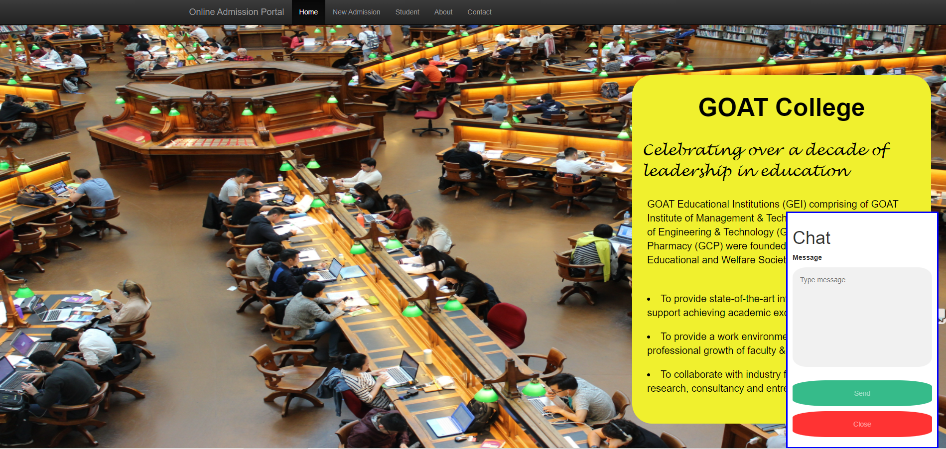
CHAT-->HELP

Slide 11
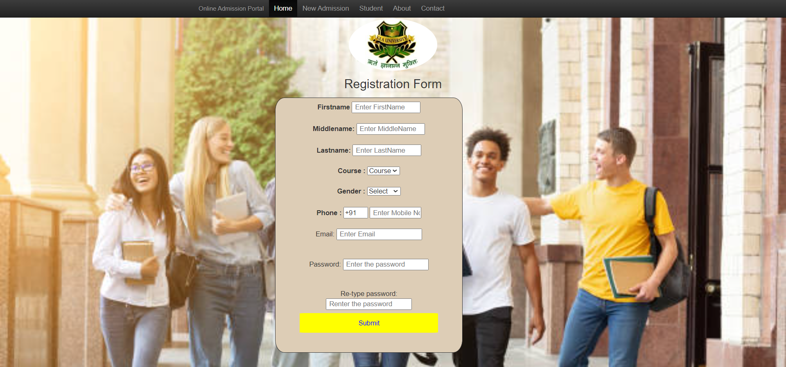
REGISTRATION

Slide 12
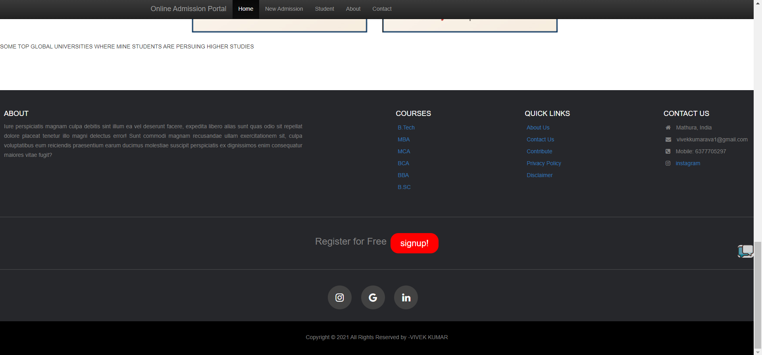
FOOTER

Slide 13
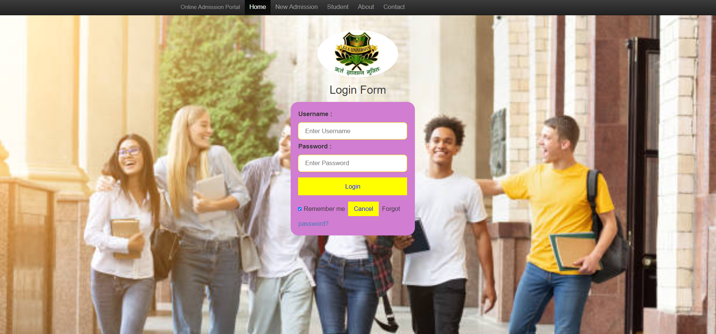
LOGIN PAGE

Slide 14
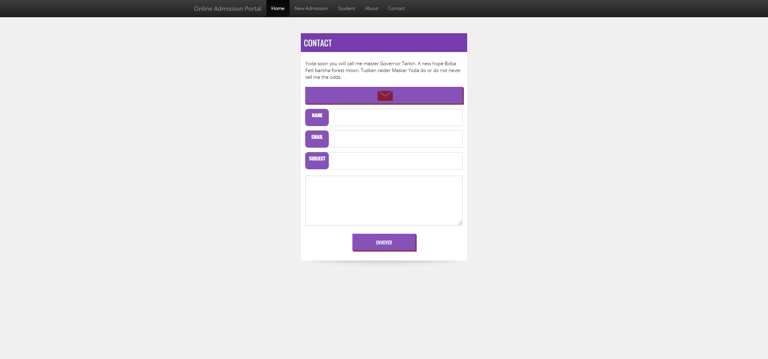
CONTACT

Slide 15
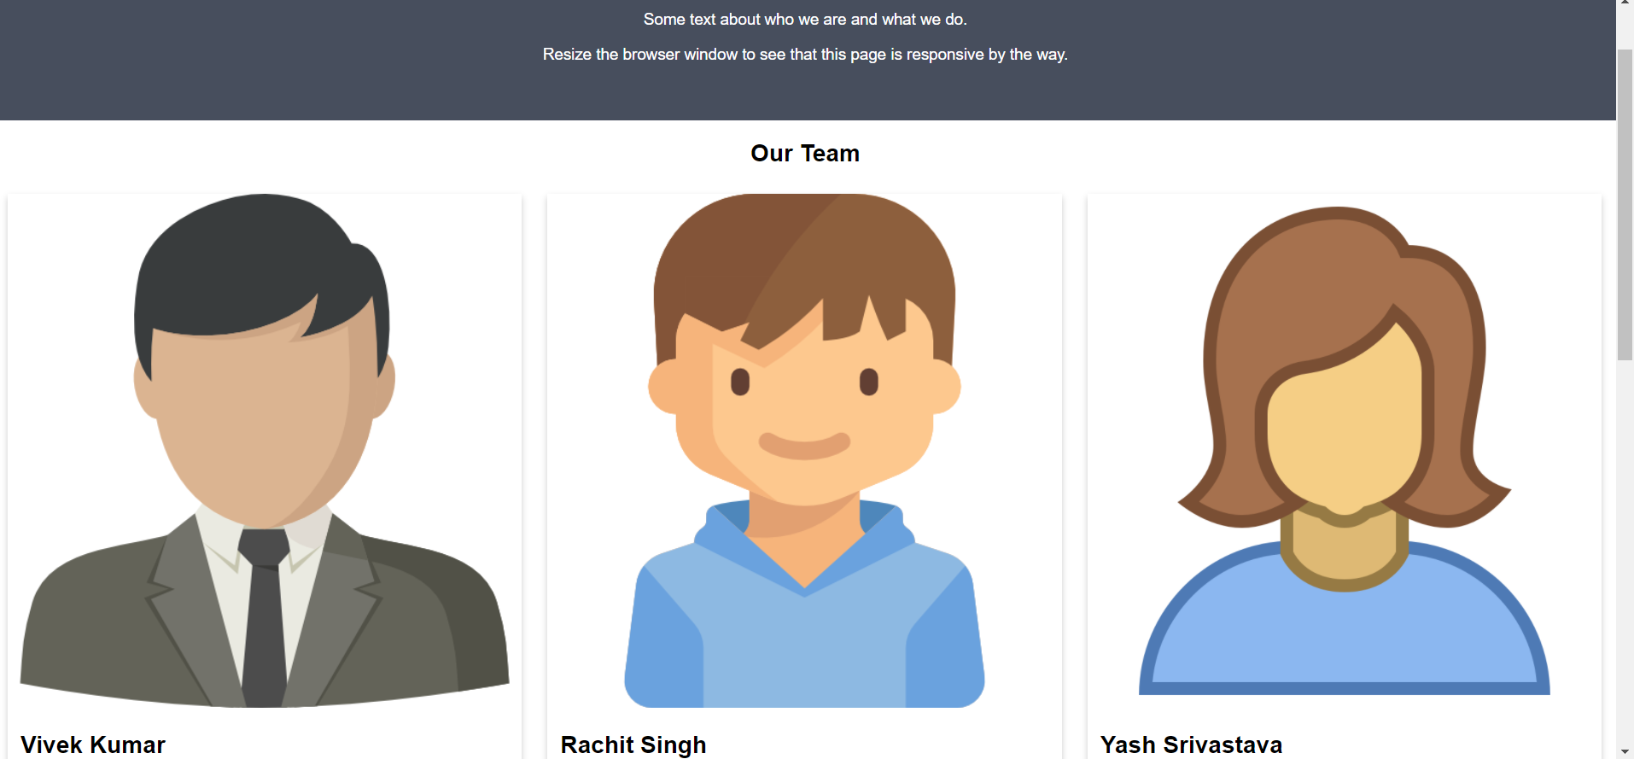
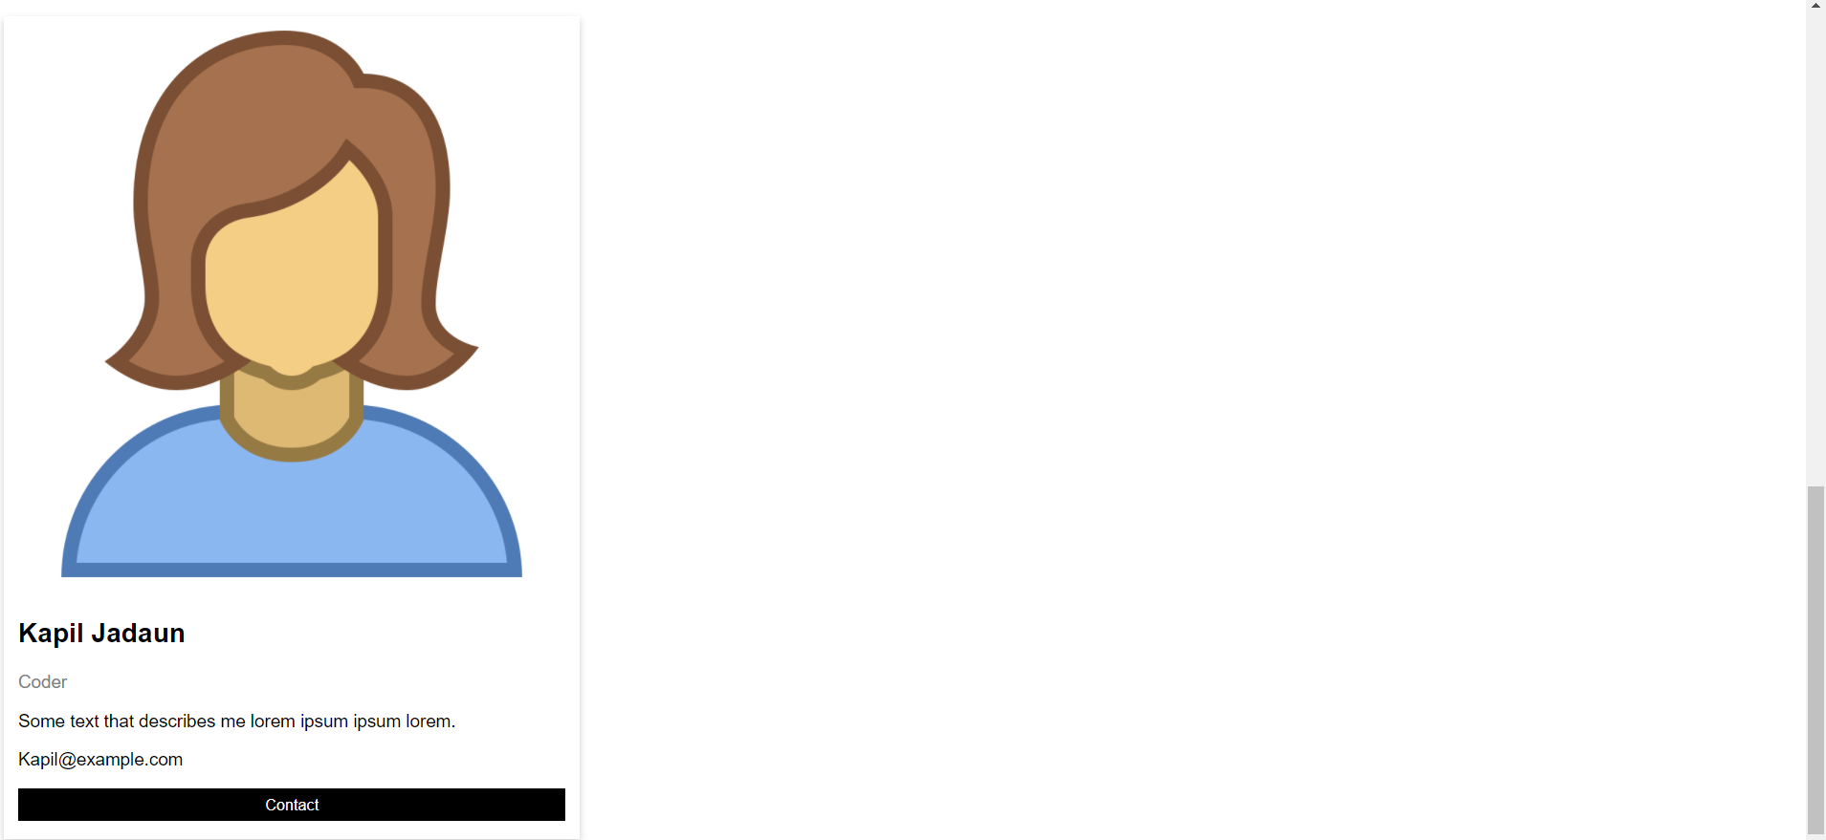
ABOUT

Slide 16
THE END

